Slide 1
Curs 06.
WBT questions
Verificare, validare şi testare automată
[19 Octombrie 2019]
Lector dr. Camelia Chisăliţă-Creţu
Universitatea Babeş-Bolyai, NTT Data
Programul Postuniversitar de Pregătire şi Formare Profesională în Informatică

Slide 2
Conţinut
Exercises:
  E1 ----> E4
Questions:
  Q1 ----> Q21

Slide 3
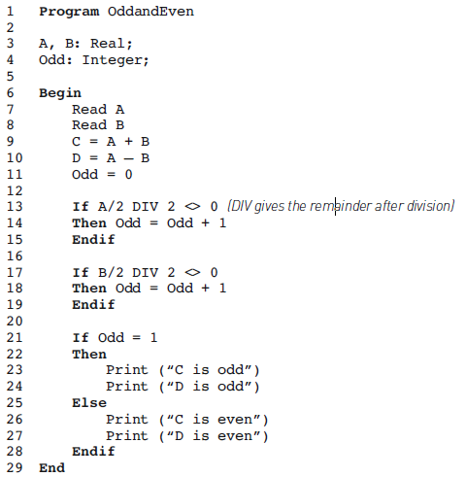
Exercise 1
Scenario:
  Let be the following source code.
Tasks:
  Draw a control flow graph to represent it.

Slide 4
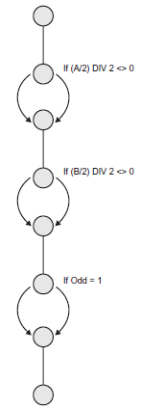
Exercise 1
ANSWERS:
    Draw a control flow graph to represent it.

Slide 5
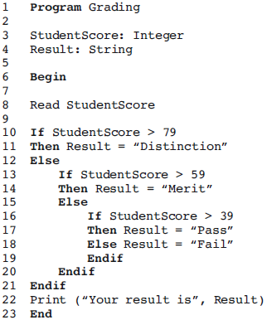
Exercise 2
Scenario:
  Let be the Grading program presented below.
Tasks:
  Compute the number of test cases required for 100% statement coverage.
  Will 100% statement coverage be achieved with a given set of data?
  Suppose we ran two test cases, as follows:
    Test Case 1: StudentScore = 50
    Test Case 2: StudentScore = 30
    Questions:
    3.1. Would 100% statement coverage be achieved?
    3.2. If not, which lines of pseudo code will not be exercised?

Slide 6
Exercise 2
ANSWERS:
  1. Compute the number of test cases required for 100% statement coverage.
  The answer is 4 because there are three decisions and every outcome has an executable statement in it.
  2. Will 100% statement coverage be achieved with a given set of data?
  No, 100% statement coverage would not be achieved. We know from 1. that four test cases are needed.
  3. Suppose we ran two test cases, as follows:
    Test Case 1: StudentScore = 50
    Test Case 2: StudentScore = 30
    Questions:
    3.1. Would 100% statement coverage be achieved?
    3.2. If not, which lines of pseudo code will not be exercised?
  Statements 11 and 14 would not be exercised because they need inputs higher than 79 and 59 respectively.

Slide 7
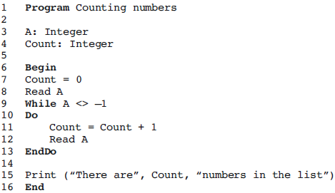
Exercise 3
Scenario:
  The following program reads a list of non-negative numbers terminated by −1.
Tasks:
  Compute how many test cases are needed to achieve 100% decision coverage.
  Calculate the level of decision coverage would be achieved by the single input A = –1.

Slide 8
Exercise 3
ANSWERS:
  1. Compute how many test cases are needed to achieve 100% decision coverage.
  The answer is 1, because a single list terminated by −1 (say 4, 6, 3, −1) will enter the loop the first three times and then exit on the fourth. The WHILE decision will be true three times and then false, which exercises the decision in both directions with one test case.
  A single test case with values of 1, −1 would also exercise all decisions.
  2. Calculate the level of decision coverage would be achieved by the single input A = –1.
  Decision coverage of 50% will be achieved. The –1 input will make the While condition False and the loop will not be entered. The program will print the message ‘There are 0 integers in the list’ and terminate, so the True outcome of the decision will not be exercised.

Slide 9
Exercise 4
Scenario:
  A vending machine dispenses either hot or cold drinks. If you choose a hot drink (e.g. tea or coffee), it asks if you want milk (and adds milk if required), then it asks if you want sugar (and adds sugar if required), then your drink is dispensed.
Tasks:
  Draw a control flow diagram for this example. (Hint: You may see the selection of the type of drink as one statement.)
  Given the following tests, what is the statement coverage achieved? What is the decision coverage achieved?
      Test 1: Cold drink
      Test 2: Hot drink with milk and sugar
  What additional tests would be needed to achieve 100% statement coverage?
  What additional tests would be needed to achieve 100% decision coverage?

Slide 10
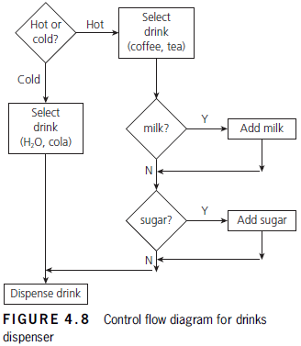
Exercise 4
ANSWERS:
  1. Draw a control flow diagram for this example. (Hint: You may see the selection of the type of drink as one statement.)
  The control flow diagram is shown in Figure 4.8. Note that drawing a control diagram here illustrates that structural testing can also be applied to the structure of general processes, not just to computer algorithms.
  Flowcharts are generally easier to understand than text when you are trying to describe the results of decisions taken on later events.

Slide 11
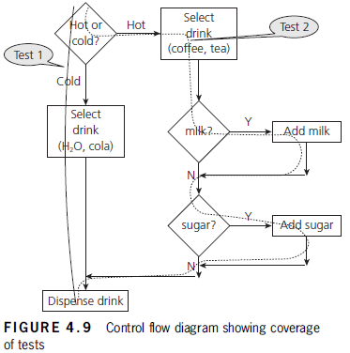
Exercise 4
ANSWERS:
2. Given the following tests, what is the statement coverage achieved? What is the decision coverage achieved?
    Test 1: Cold drink
    Test 2: Hot drink with milk and sugar
On Figure 4.9, we can see the route that Tests 1 and 2 have taken through our control flow graph. Test 1 has gone straight down the left-hand side to select a cold drink. Test 2 has gone to the right at each opportunity, adding both milk and sugar to a hot drink.
a. Every statement (represented by a box on the diagram) has been covered by our two tests, so we have 100% statement coverage.
b. We have not taken the No Exit from either the ‘milk?’ or ‘sugar?’ decisions, so there are two decision outcomes that we have not tested yet. We did test both of the outcomes from the ‘hot or cold?’ decision, so we have covered four out of six decision outcomes. Decision coverage is 4/6 or 67% with the two tests.

Slide 12
Exercise 4
ANSWERS:
3. What additional tests would be needed to achieve 100% statement coverage?
  No additional tests are needed to achieve statement coverage, as we already have 100% coverage of the statements.
4. What additional tests would be needed to achieve 100% decision coverage?
  One additional test is needed to achieve 100% decision coverage:
  Test 3: Hot drink, no milk, no sugar
  This test will cover both of the ‘No’ decision outcomes from the milk and sugar decisions, so we will now have 100% decision coverage.

Slide 13
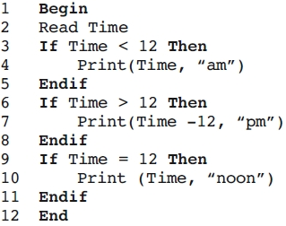
Q1
Consider the following pseudo code:
How many test cases are needed to achieve
100 per cent decision coverage?
  a. 1
  b. 3
  c. 2
  d. 4
The three decisions are in sequence and the conditions are all mutually exclusive (if any one is true the others must be false). Hence a test case that makes the first decision true will make the second and third decisions false and so on. So,
  test case 1 (say Time = 6) would exercise the path True, False, False;
  test case 2 (say Time = 15) would exercise the path False, True, False;
  test case 3 would have to be Time = 12.
This combination achieves 100 per cent decision coverage because each decision has been exercised through its true and its false outcomes.

Slide 14
Q2
Consider the following pseudo code:
If the test cases Time = 11 and Time = 15 were input,
what level of decision coverage would be achieved?
  a. 100% or 6/6
  b. 50% or 3/6
  c. 67% or 4/6
  d. 83% or 5/6
Test case 1 exercises the decision outcomes True, False, False.
Test case 2 exercises the decision outcomes False, True, False.
This leaves the True outcome of decision 3 not exercised.
Of the 6 possible decision outcomes, 5 have been exercised, so the decision coverage is 5/6 (about 83%).

Slide 15
Q3
Which of the following statements about the relationship between statement coverage and decision coverage is correct?
  a. 100% decision coverage always means 100% statement coverage.
  b. 100% statement coverage is achieved if decision coverage is greater than 90%.
  c. 100% decision coverage is achieved if statement coverage is greater than 90%.
  d. 100% statement coverage always means 100% decision coverage.

Slide 16
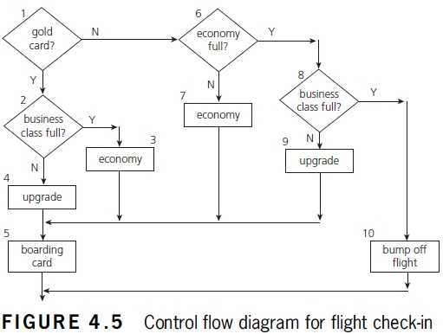
Q4
If you are flying with an economy ticket, there is a possibility that you may get upgraded to business class, especially if you hold a gold card in the airline’s frequent flier program.
If you don’t hold a gold card, there is a possibility that you will get ‘bumped’ off the flight if it is full and you check in late.
This is shown in Figure 4.5. Note that each box (i.e. statement) has been numbered.
Three tests have been run:
Test 1: Gold card holder who gets upgraded to business class.
Test 2: Non-gold card holder who stays in economy.
Test 3: A person who is bumped from the flight.
What is the statement coverage of these three tests?
a. 80%
b. 60%
c. 70%
d. 90%

Slide 17
Q5
Condition coverage checks each of the ways that the condition can be made true or false.
  a. True
  b. False

Slide 18
Q6
Select the criteria(s) that is not used for path testing:
a. Line coverage;
  b. Requirements coverage;
  c. Branch coverage;
  d. Condition coverage.

Slide 19
Q7
White box testing is a kind of testing that a programmer does during coding.
  a. True
  b. False

Slide 20
Q8
What does it mean if a set of tests has achieved 90% statement coverage?
  a. 9 out of 10 statements have been exercised by this set of tests.
  b. 9 out of 10 decision outcomes have been exercised by this set of tests.
  c. 9 out of 10 tests have been run on this set of software.
  d. 9 out of 10 requirements statements about the software are correct.

Slide 21
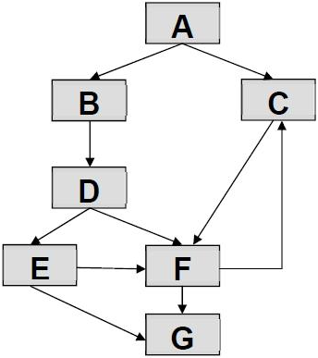
Q9
One of the test goals for your project is to have 100% decision coverage. The following three tests have been executed for the control flow graph shown below.
  Test_01 covers path: A, B, D, E, G;
  Test_02 covers path: A, B, D, E, F, G;
  Test_03 covers path: A, C, F, C, F, C, F, G.
Which of the following statements related to the decision coverage goal is TRUE?
  a. Decision D has not been tested completely.
  b. 100% decision coverage has been achieved.
  c. Decision E has not been tested completely.
  d. Decision F has not been tested completely.
In the diagram there are following four conditions/decisions: A, D, E. F. Hence
  condition A is covered (A->B by Test_01 and A->C by Test_03);
  condition E is covered (E->G by Test_01 and E->F by Test_02);
  condition F is covered (F->C by Test_02 and F->G by Test_02 and Tests_03);
  condition D is not covered, there is only D->E by Test_01, but D->F is not covered.

Slide 22
Q10
Given the following code, which is true about the minimum number of test cases required for full statement and branch coverage:
  Read P
  Read Q
  IF P+Q > 100 THEN
  Print “Large”
  ENDIF
  If P > 50 THEN
  Print “P Large”
  ENDIF
  a. 1 test for statement coverage, 3 for branch coverage;
  b. 1 test for statement coverage, 2 for branch coverage;
  c. 1 test for statement coverage, 1 for branch coverage;
  d. 2 tests for statement coverage, 3 for branch coverage;
  e. 2 tests for statement coverage, 2 for branch coverage.

Slide 23
Q11
Given the following:
  Switch PC on
  Start “outlook”
  IF outlook appears THEN
  Send an email
  Close outlook
Which is true about the minimum number of test cases required for full statement and branch coverage:
  a. 1 test for statement coverage, 1 for branch coverage;
  b. 1 test for statement coverage, 2 for branch coverage;
  c. 1 test for statement coverage. 3 for branch coverage;
  d. 2 tests for statement coverage, 2 for branch coverage;
  e. 2 tests for statement coverage, 3 for branch coverage.

Slide 24
Q12
Given the following code:
  IF A > B THEN
  C = A – B
  ELSE
  C = A + B
  ENDIF
  Read D
  IF C = D Then
  Print “Error”
  ENDIF
Which is true about the minimum number of test cases required for full statement and branch coverage:
  a. 1 test for statement coverage, 3 for branch coverage;
  b. 2 tests for statement coverage, 2 for branch coverage;
  c. 2 tests for statement coverage. 3 for branch coverage;
  d. 3 tests for statement coverage, 3 for branch coverage;
  e. 3 tests for statement coverage, 2 for branch coverage.

Slide 25
Q13
Consider the following:
  Pick up and read the newspaper
  Look at what is on television
  If there is a program that you are interested in watching
  then switch the television on and watch the program
  Otherwise
  Continue reading the newspaper
  If there is a crossword in the newspaper
  then try and complete the crossword
Which is true about the minimum number of test cases required for full statement (SC) and branch/decision coverage (DC):
  a. SC = 1 and DC = 1;
  b. SC = 1 and DC = 2;
  c. SC = 1 and DC = 3;
  d. SC = 2 and DC = 2;
  e. SC = 2 and DC = 3.

Slide 26
Q14
Consider the following statements:
  i. 100% statement coverage guarantees 100% branch coverage.
  ii. 100% branch coverage guarantees 100% statement coverage.
  iii. 100% branch coverage guarantees 100% decision coverage.
  iv. 100% decision coverage guarantees 100% branch coverage.
  v. 100% statement coverage guarantees 100% decision coverage.
  a. ii is True; i, iii, iv & v are False;
  b. i & v are True; ii, iii & iv are False;
  c. ii & iii are True; i, iv & v are False;
  d. ii, iii & iv are True; i & v are False.

Slide 27
Q15
Minimum Test Required for Statement Coverage :
  Disc = 0
  Order-qty = 0
  Read Order-qty
  If Order-qty >=20 then
  Disc = 0.05
  If Order-qty >=100 then
  Disc =0.1
  End if
  End if
  a. Statement coverage is 4;
  b. Statement coverage is 1;
  c. Statement coverage is 3;
  d. Statement Coverage is 2.

Slide 28
Q16
Given the following program:
  IF X = Z
  THEN Statement 2;
  END
McCabe’s Cyclomatic Complexity is :
  a. 2;
  b. 3;
  c. 4;
  d. 5.

Slide 29
Q17
How many test cases are necessary to cover all the possible sequences of statements (paths) for the following program fragment? Assume that the two conditions are independent of each other:
  if (Condition 1)
  then statement 1
  else statement 2
  fi
  if (Condition 2)
  then statement 3
  fi
  a. 2 Test Cases;
  b. 3 Test Cases;
  c. 4 Test Cases;
  d. Not achievable.

Slide 30
Q18
If the pseudo code below were a programming language, how many tests are required to achieve 100% statement coverage?
  1. If x=3 then
  2. Display_messageX;
  3. EndIf
  4. If y=2 then
  5. Display_messageY;
  6. Else
  7. Display_messageZ;
  8. EndIf
  a. 1;
  b. 2;
  c. 3;
  d. 4.

Slide 31
Q19
If the pseudo code below were a programming language, how many tests are required to achieve 100% decision coverage?
  1. If x=3 then
  2. Display_messageX;
  3. EndIf
  4. If y=2 then
  5. Display_messageY;
  6. Else
  7. Display_messageZ;
  8. EndIf
  a. 1;
  b. 2;
  c. 3;
  d. 4.

Slide 32
Q20
If the pseudocode below were a programming language, how many tests are required to achieve 100% statement coverage?
  1. If x=3 then
  2. Display_messageX;
  3. If y=2 then
  4. Display_messageY;
  5. Else
  6. Display_messageZ;
  7. EndIf
  8. Else
  9. Display_messageK;
  10. EndIf
  a. 1;
  b. 2;
  c. 3;
  d. 4.

Slide 33
Q21
If the pseudocode below were a programming language, how many tests are required to achieve 100% decision coverage?
  1. If x=3 then
  2. Display_messageX;
  3. If y=2 then
  4. Display_messageY;
  5. Else
  6. Display_messageZ;
  7. EndIf
  8. Else
  9. Display_messageK;
  10. EndIf
  a. 1;
  b. 2;
  c. 3;
  d. 4.

